Slide 1
Types of Generators
CSE A & B
By
Ms. Alagu Dheeraj

Slide 2
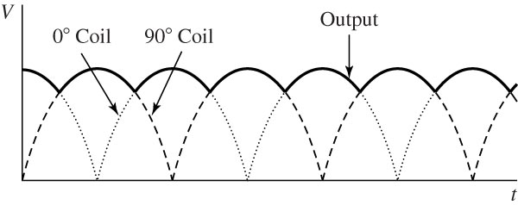
Coil and output waveforms for a two-winding rotor.

Slide 3
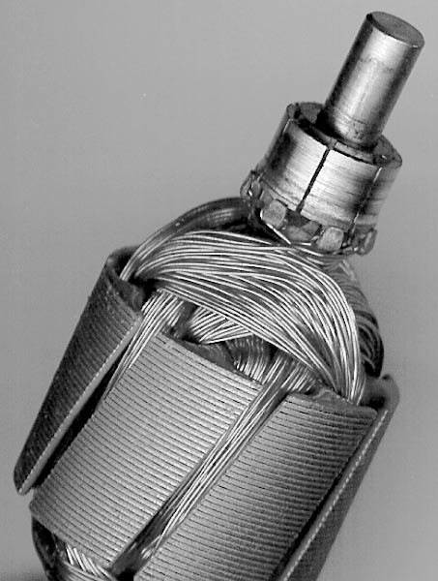
Rotor with several rotor coils and commutator segments.

Slide 4
Types of DC Machines
Both the armature and field circuits carry direct current in the case of a DC machine.
Types:
Self-excited DC machine: when a machine supplies its own excitation of the field windings. In this machine, residual magnetism must be present in the ferromagnetic circuit of the machine in order to start the self-excitation process.
Separately-excited DC machine: The field windings may be separately excited from an eternal DC source.
Shunt Machine: armature and field circuits are connected in parallel. Shunt generator can be separately-excited or self-excited.
Series Machine: armature and field circuits are connected in series.

Slide 5
Shunt and Compound DC Generator
Shunt Generator Model
Series Generator Model
Compound Generator Model
Efficiency

Slide 6
Equivalent Circuit of a DC Machine
I_{f}
I_{a_gen}
I_{f}
+
I_{L}
+
I_{a_mot}
+
R_{a}
R_{a}
V_{f}
R_{f}
V_{t}
R_{f}
V_{t}
+
-
E_{a}
-
E_{a}
I_{a}
-
+
-

Slide 7
Generated emf and Electromagnetic Torque
Motor: V_{t} > E_{a}
Generator: V_{t} < E_{a}
Voltage generated in the armature circuit due the flux of the stator field current
K_{a}: design constant
Electromagnetic torque

Slide 8
Armature Reaction
If a load is connected to the terminals of the dc machine, a current will flow in its armature windings. This current flow will produce a magnetic field of its own, which will distort the original magnetic field from the machine’s field poles. This distortion of the magnetic flux in a machine as the load is increased is called the armature reaction.

Slide 9
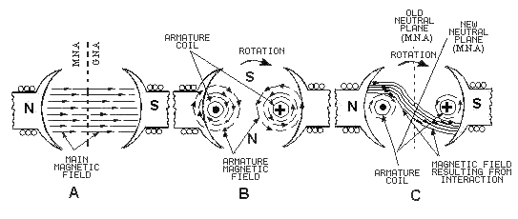
Armature Reaction
Interaction of Main field flux with Armature field flux

Slide 10
Effects of Armature Reaction
It decreases the efficiency of the machine
It produces sparking at the brushes
It produces a demagnetising effect on the main poles
It reduces the emf induced
Self excited generators some times fail to build up emf

Slide 11
Armature reaction remedies
1.Brushes must be shifted to the new position of the MNA
2.Extra turns in the field winding
3.Slots are made on the tips to increase the reluctance
4. The laminated cores of the shoe are staggered
5. In big machines the compensating winding at pole shoes produces a flux which just opposes the armature mmf flux automatically.

Slide 12
Commutation
The change in direction of current takes place when the conductors are along the brush axis .
During this reverse process brushes short circuit that coil and undergone commutation
Due to this sparking is produced and the brushes will be damaged and also causes voltage dropping.

Slide 13
Separately-Excited and Self-Excited DC Generators
I_{f}
I_{L}
I_{f}
+
I_{L}
+
+
R_{a}
R_{a}
DC Supply
R_{f}
V_{t}
R_{f}
V_{t}
+
E_{a}
E_{a}
-
I_{a}
-
-
Separately-Excited Self-Excited

Slide 14
Example 1
A 100-kW, 250-V DC shunt generator has an armature resistance of 0.05 Ω and field circuit resistance of 60 Ω. With the generator operating at rated voltage, determine the induced voltage at (a) full load, and (b) half-full load.

Slide 15
Solution to Example 1
At full load,
V_{t}=E_{a}-I_{a}R_{a}
I_{f}=250/60=4.17 A
I_{L_FL}=100,000/250=400 A
I_{a}=I_{L_FL}+I_{f}=400+4.17=404.17 A
E_{a}=V_{t}+I_{a}R_{a}=250+404.17*0.05=270.2 V
(b) At half load,
I_{f}=250/60=4.17 A
I_{L_HL}=50,000/250=200 A
I_{a}=I_{L_HL}+I_{f}=200+4.17=204.17 A
E_{a}=V_{t}+I_{a}R_{a}=250+204.17*0.05=260.2 V

Slide 16
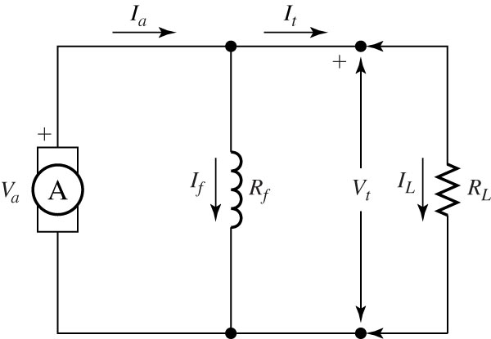
DC shunt generator model.

Slide 17
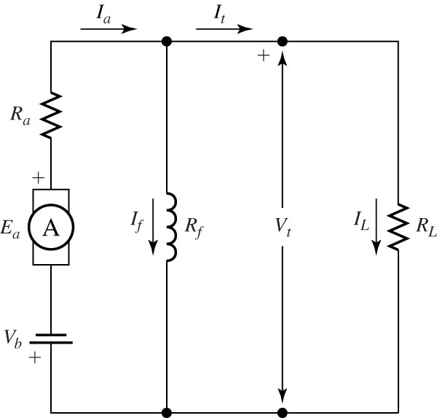
More precise dc shunt generator model.

Slide 18
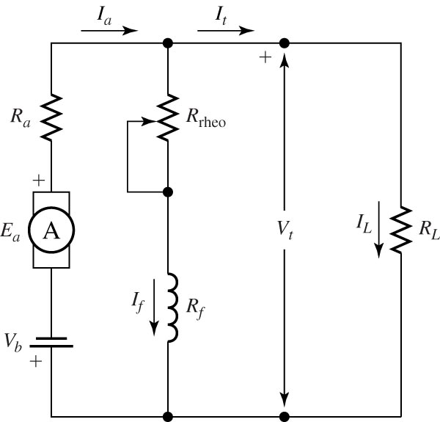
Shunt dc generator with field rheostat.

Slide 19
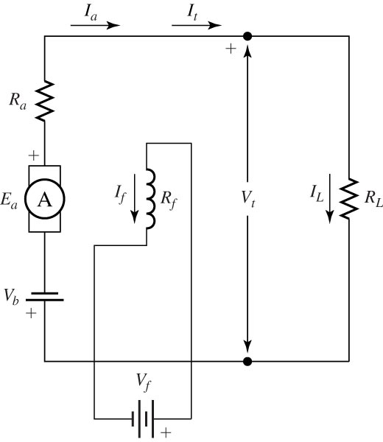
Separately excited shunt dc generator.

Slide 20
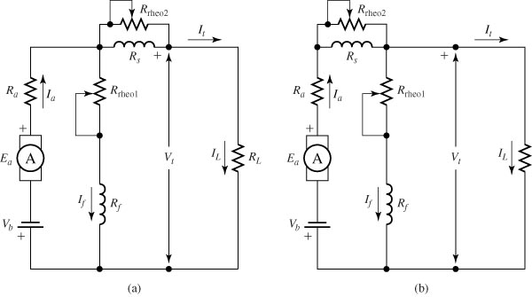
Compound generator, (a) short shunt and (b) long shunt.

